Slide 1





Infosys Springboard Virtual Internship 6.0
Project Title: ElectViz – Election Data Visualization
Submitted by: Boomika B
Under the Supervision of: Mentor Nithyasri S J

Slide 2
Introduction
ElectViz aims to visualize and analyze large-scale election data using Microsoft Power BI.
Converts raw, unstructured datasets into interactive and insightful dashboards.
Displays party-wise votes, constituency-level results, voter turnout, and demographic insights.
Enables users to explore data dynamically using filters, slicers, and drill-down features.
Enhances transparency, accuracy, and accessibility in understanding election trends.
Serves as a tool for media, analysts, and policymakers to interpret election data effectively.

Slide 3
System Design & Workflow
Converts raw election data into interactive dashboards
Ensures data accuracy, reliability, and clarity
Workflow Steps:
Data Collection: From Kaggle
Includes: Party-wise votes, turnout, constituency, and demographics
Data Preprocessing: Uses Power Query for cleaning and merging data
Removes: Duplicates, missing values, and formatting errors
Data Modeling: Builds relationships between tables
Uses DAX: Calculates vote share %, turnout, and winning margins
Visualization: Creates bar, donut, and map charts
Adds: Filters, slicers, and drill-through options
User Interaction & Reporting: Compare states, parties, and years
Generates: Visual reports for sharing and export
Result: Fast, reliable, and interactive analysis for meaningful insights

Slide 4
Future Enhancements
Integration of real-time data streams from electoral APIs.
Implementation of AI-based predictions for upcoming elections.
Addition of advanced visuals – animated maps, trend lines, and heatmaps.
Expansion to mobile and web platforms for easy access.
Inclusion of socio-economic and sentiment data for deeper insights.

Slide 5
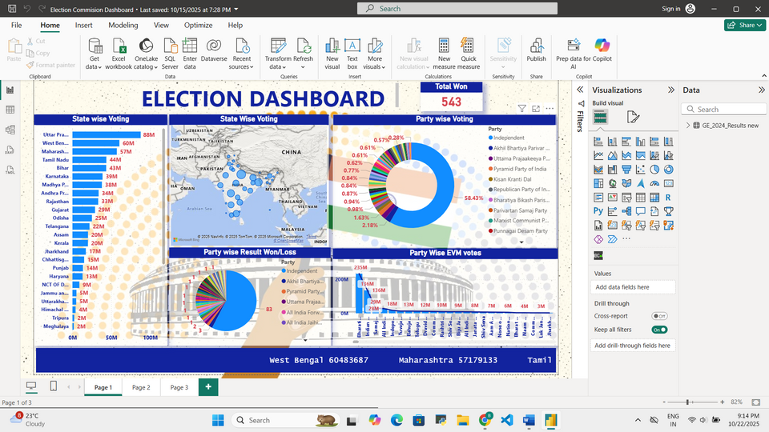
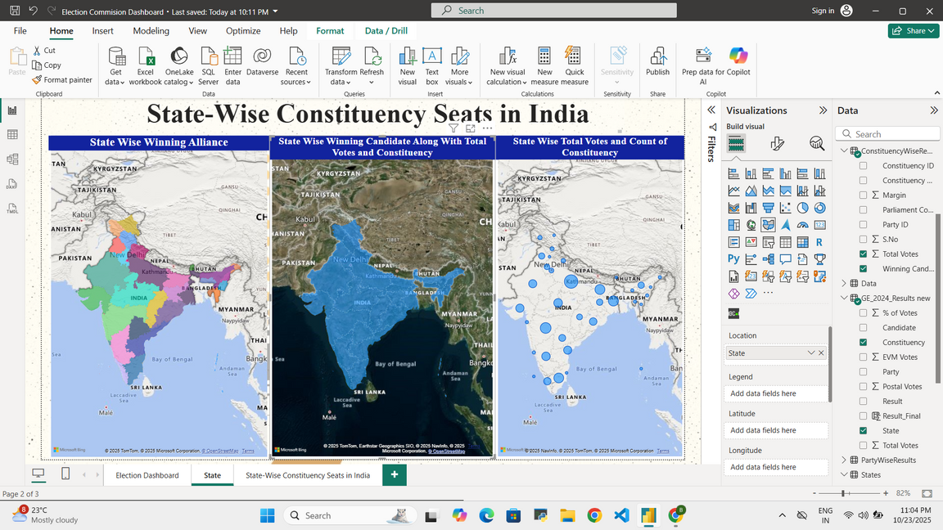
SCREENSHOTS

Slide 6
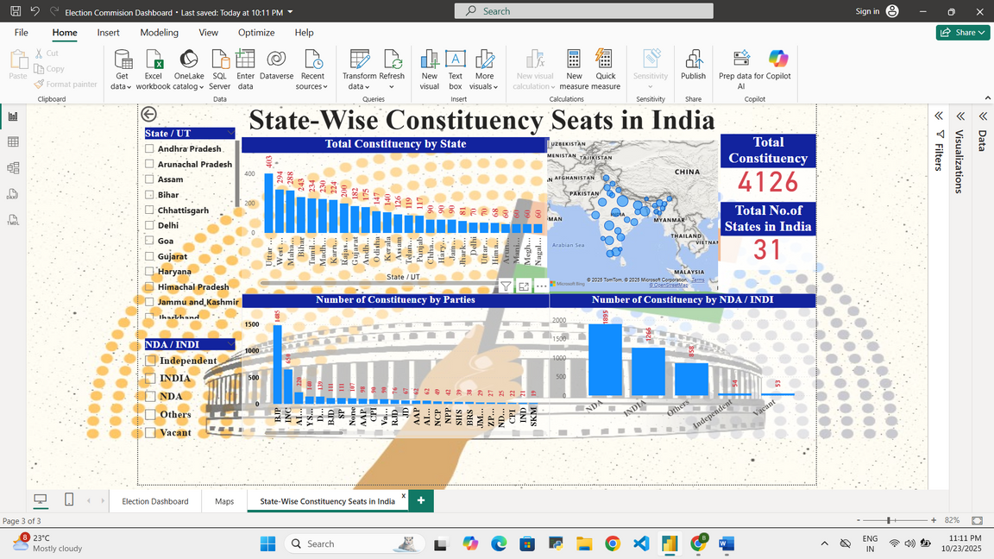
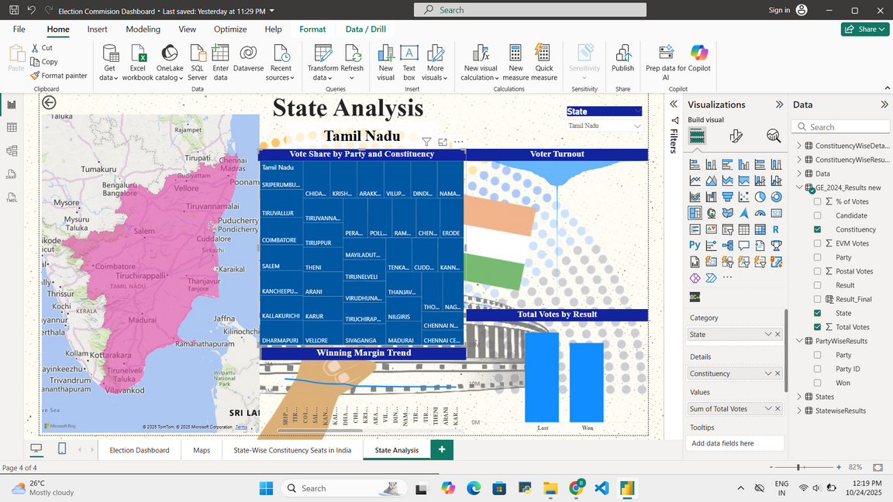
SCREENSHOTS

Slide 7
Conclusion
ElectViz demonstrates how data visualization technologies simplify complex electoral data.
Enhances understanding of party performance, voter behavior, and regional variations.
Promotes clarity and engagement in the democratic process through visual analytics.
Establishes Power BI as a powerful tool for analytical storytelling.
Future improvements will make ElectViz a complete electoral intelligence platform, integrating AI and real-time insights.
Encourages a data-driven approach to governance and public awareness.

Slide 8
Thank
You

